Slide 1


Sales Insights - Data Analysis Project using Tableau
By – Sandeep choubey
github.com/perfect_dash
linkedin.com/in/sandeepchoubey

Slide 2
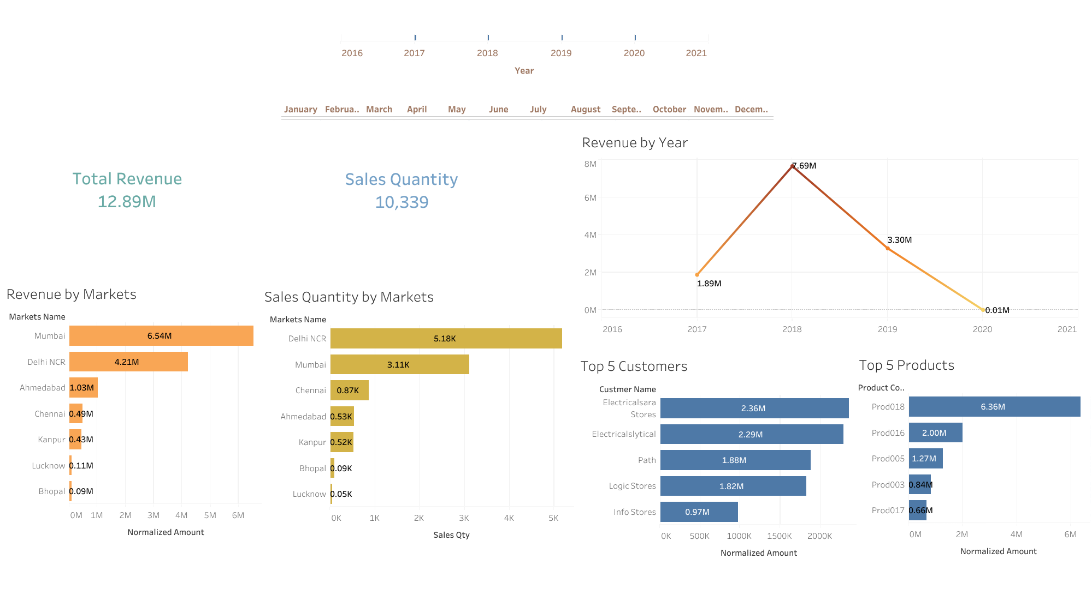

Slide 3
